Slide 1
PHISHING ATTACK DETECTION USING MACHINE LEARNING
RIYA VINCENT - MCA431

Slide 2
CONTENTS
Introduction
Related Works
Gap Identified
Problem
Objective
Methodology
Conclusion

Slide 3
INTRODUCTION
The internet is growing very fast and everyone is using it because it can afford all needs online as well as providing a wide range of services. As the use of the internet rapidly increase the requirement of providing confidential and critical data transmissions raises. This has revealed it to a wide range of security attacks, Therefore, it is important to implement web applications security techniques while developing an online web application.

Slide 4
….
Besides these attacks, phishing is one of the most common social engineering attacks that is used by attackers to steal critical and sensitive information by disguising themselves as trustworthy organizations, phishing has compromised millions of users’ data.

Slide 5
RELATED WORKS
SL.NO | Title of the Paper, Journal name, Publisher , Year
1 | Applying machine learning and natural language processing to detect phishing email AreejAlhogail,AfrahAlsabih,18 July 2021
2 | AI Meta-Learners and Extra-Trees Algorithm for the Detection of Phishing Websites -YAZAN AHMAD ALSARIERA 1 , VICTOR ELIJAH ADEYEMO 2 , ABDULLATEEF OLUWAGBEMIGA BALOGUN 3,4, (Member, IEEE), AND AMMAR KAREEM ALAZZAWI 3
3 | A Deep Learning-Based Framework for Phishing Website Detection -LIZHEN TANG AND QUSAY H. MAHMOUD
.

Slide 6
GAP IDENTIFIED
A culture of distraction
Spear phishing can be almost undetectable
Curiosity
users lack security awareness. ...

Slide 7
PROBLEM
Nowadays making any online web application without securing it properly makes it vulnerable to cyber-attacks.
Hackers all over the world can attack your website and gain secret information or make serious damage to your website.

Slide 8
…..
when a user opens a link contains a malicious JavaScript code, it might steal personal information or hijack a web session, and many different hacking scenarios can happen.
Hackers will also often insert phishing links into a website, detecting phishing links manually by searching every page in the website is inefficient, time-consuming and requires security expert

Slide 9
OBJECTIVES
To overcome this problem machine learning techniques (Artificial Neural Networks and XGBoost) has been used so that our computer can take real-time decisions and can classify in advance that whether a particular site is a phishing site or not based on previously collected data.

Slide 10
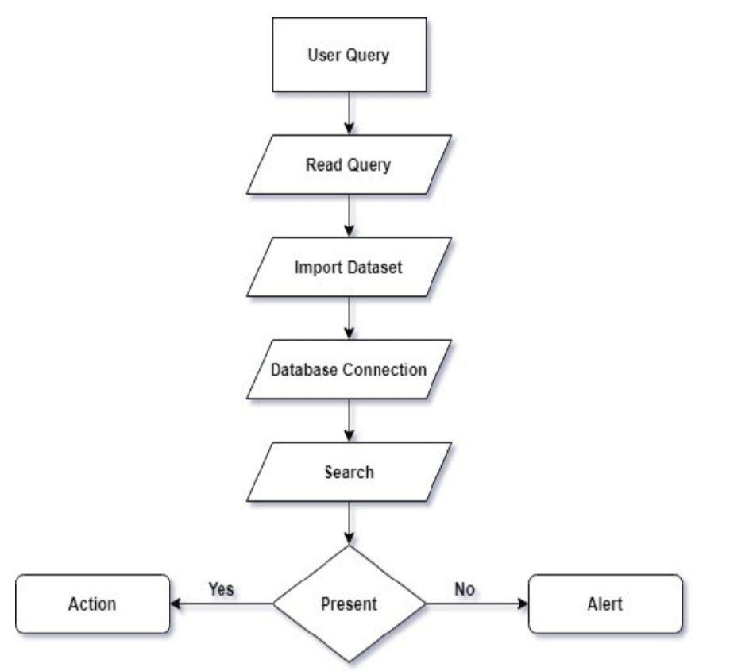
METHODOLOGY

Slide 11
…
Collection of the data for testing purposes. We will collect the data from the dataset and then use it for classification.
Then splitting the data into train and test sets. These sets will be divided in the ratio of 80:20. The train set will be used in training the model and the test set will be used in verifying our model.
Building the model is applying the algorithms, i.e., implementing the ANN and the XGBoost algorithms.
Training the model using the test set which will train the ANN and the XGBoost models.
Importing links to the prediction step is the main step after the training of the model. This is testing the model for accuracy and checking whether the model is implemented successfully or not.

Slide 12
CONCLUSION
This project aims to enhance detection method to detect phishing websites using machine learning technology. It will achieve 85.14% detection accuracy using XGBoost algorithm.
I

Slide 13
THANK YOU

